Slide 1

SOS vs Convex
and Generalized Cauchy-Schwarz
Bachir El Khadir
Mar 2, 2020
Mathematisches Forschungsinstitut Oberwolfach

Slide 2
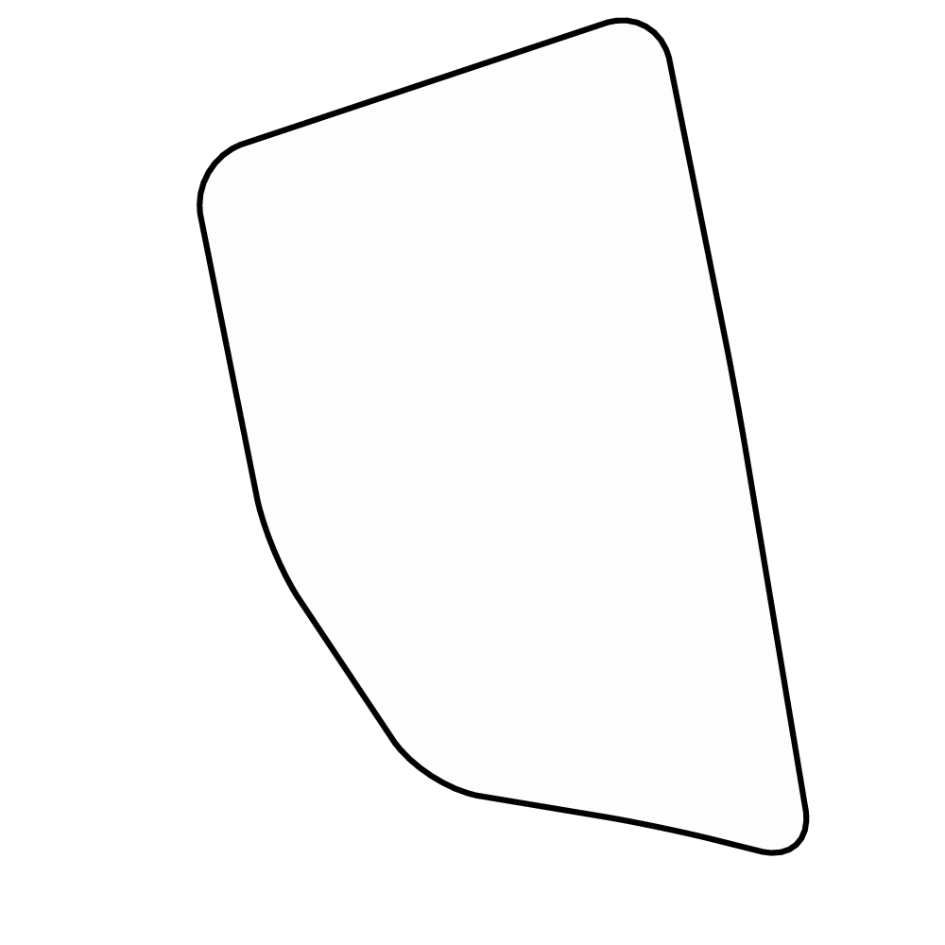
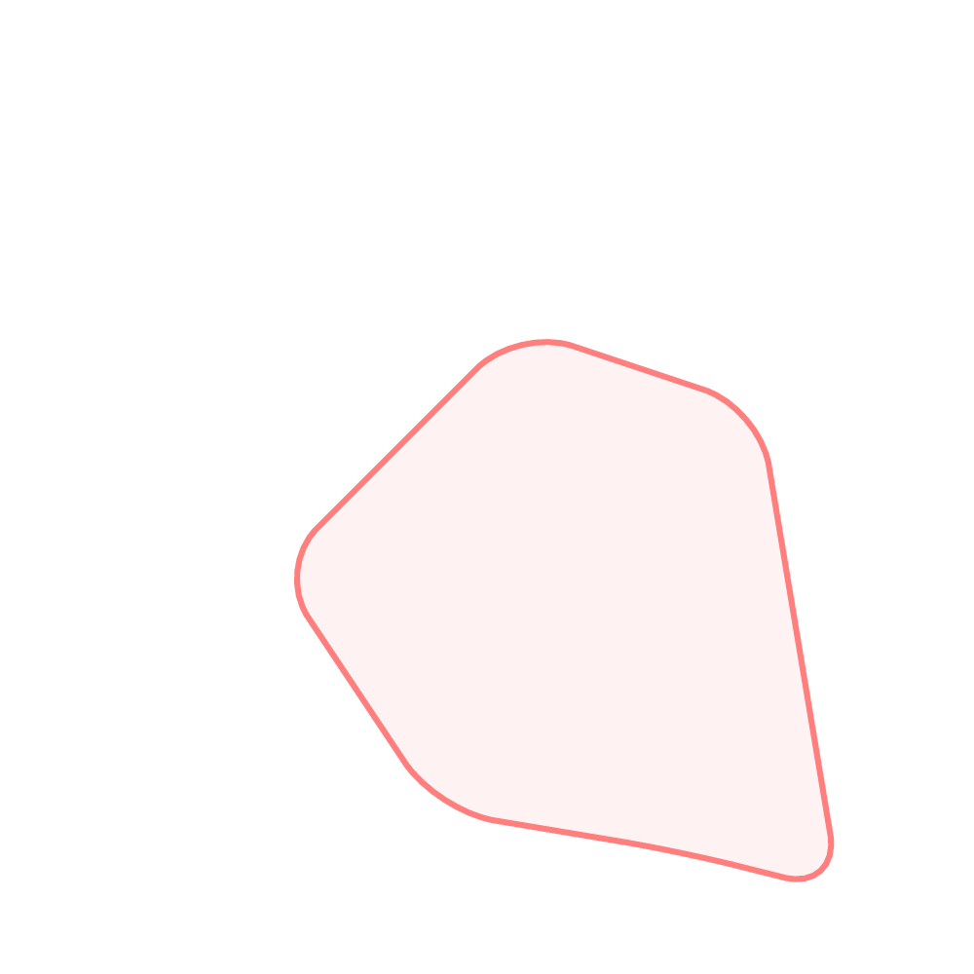
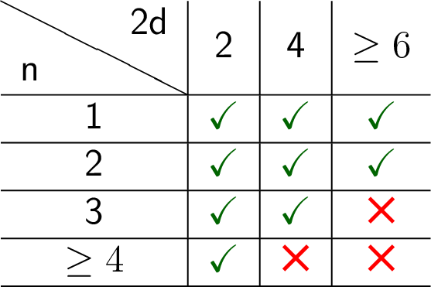
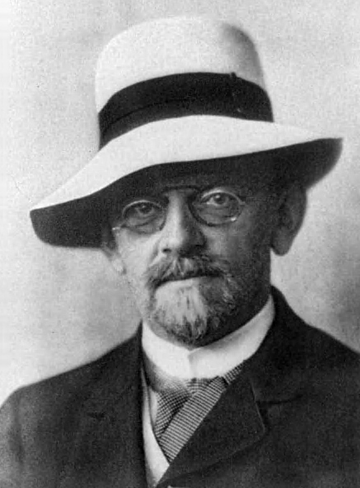
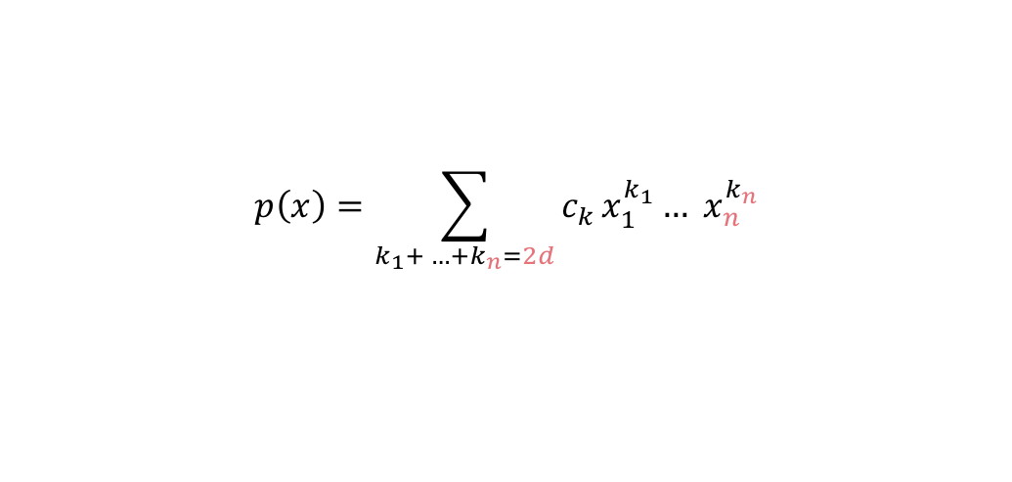
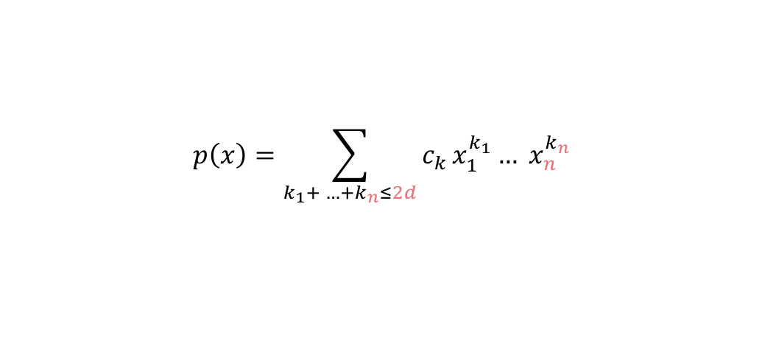
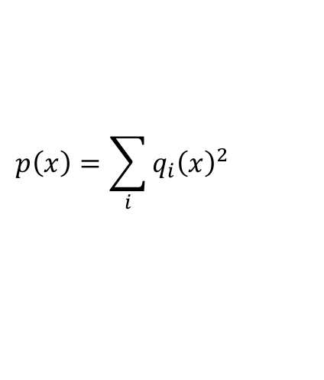
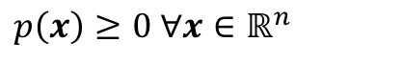
$$p\left(x\right)=\sum_{k_{1}+ …+k_{n}≤2d}{c_{k }x_{1}^{k_{1}}… x_{n}^{k_{n}}}$$
$$p\left(x\right)=\sum_{k_{1}+ …+k_{n}=2d}{c_{k }x_{1}^{k_{1}}… x_{n}^{k_{n}}}$$
$p\left(x\right)≥0 ∀x∈ℝ^{n}$
Robinson (1973)
Nonnegative SOS ?
Motzkin (1967)
[Hilbert, 1888]
$$p\left(x\right)=\sum_{i}{q_{i}{\left(x\right)}^{2}}$$
Notes:
The object of interest to us Is multivariate poly
When we study polynomials, a property that we are interested in is nonnegativity
I plotted for you here the set of all nonnegative polynomials in n d
Inside this set, we have two other sets of interest

Slide 3
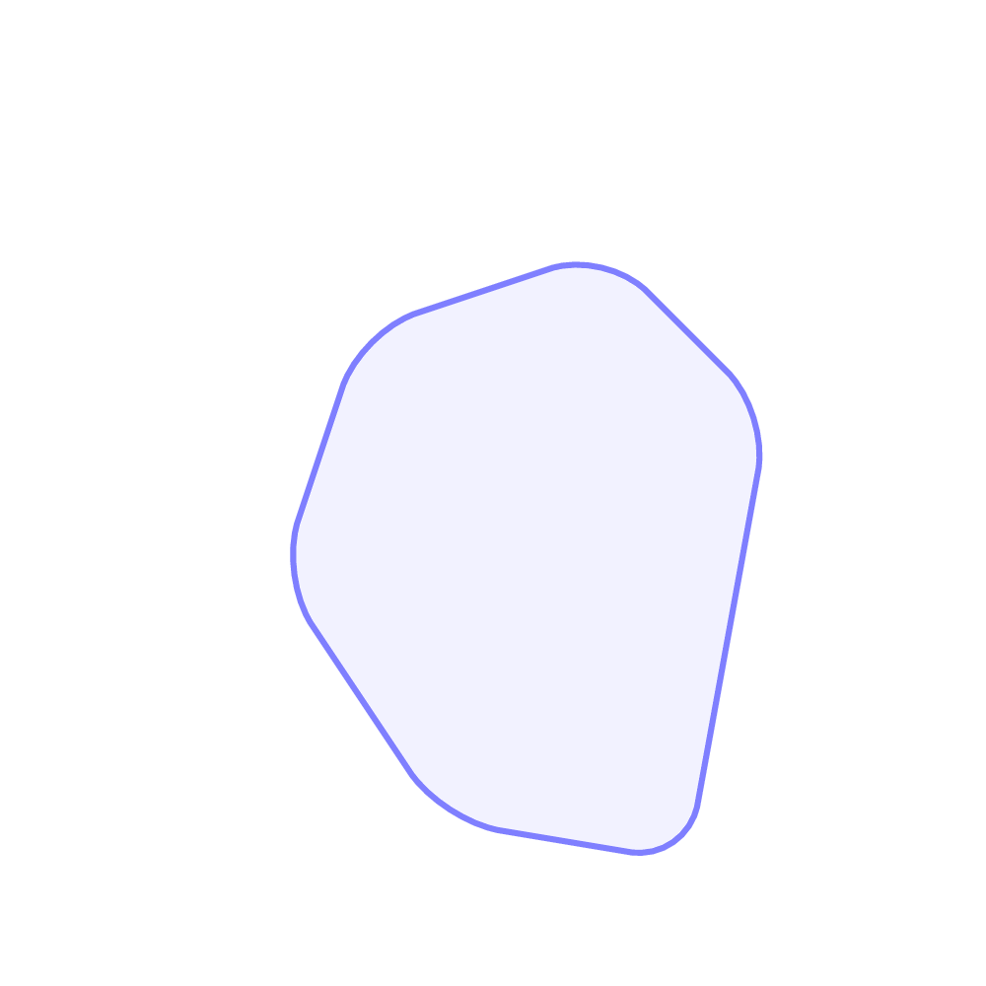
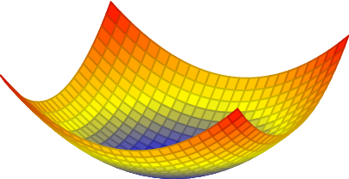
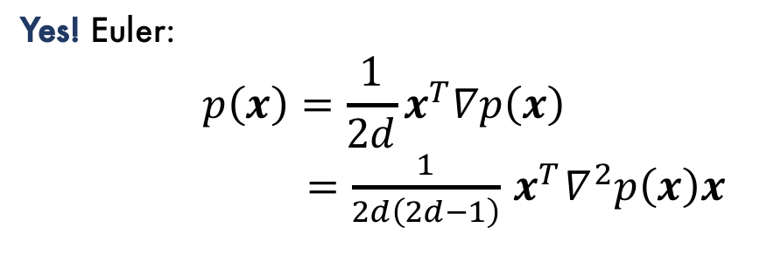
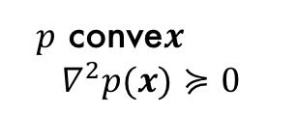
$p\left(x\right)≥0 ∀x∈ℝ^{n}$
Convex Nonnegative ?
Yes! Euler:
$$p\left(x\right)=\frac{1}{2d}x^{T}∇p\left(x\right)$$
$=\frac{1}{2d\left(2d−1\right)}{ x}^{T}∇^{2}p\left(x\right)x$
$p$ conve𝒙
$$∇^{2}p(x)≽0$$
Notes:
The object of interest to us Is multivariate poly
When we study polynomials, a property that we are interested in is nonnegativity
I plotted for you here the set of all nonnegative polynomials in n d
Inside this set, we have two other sets of interest

Slide 4
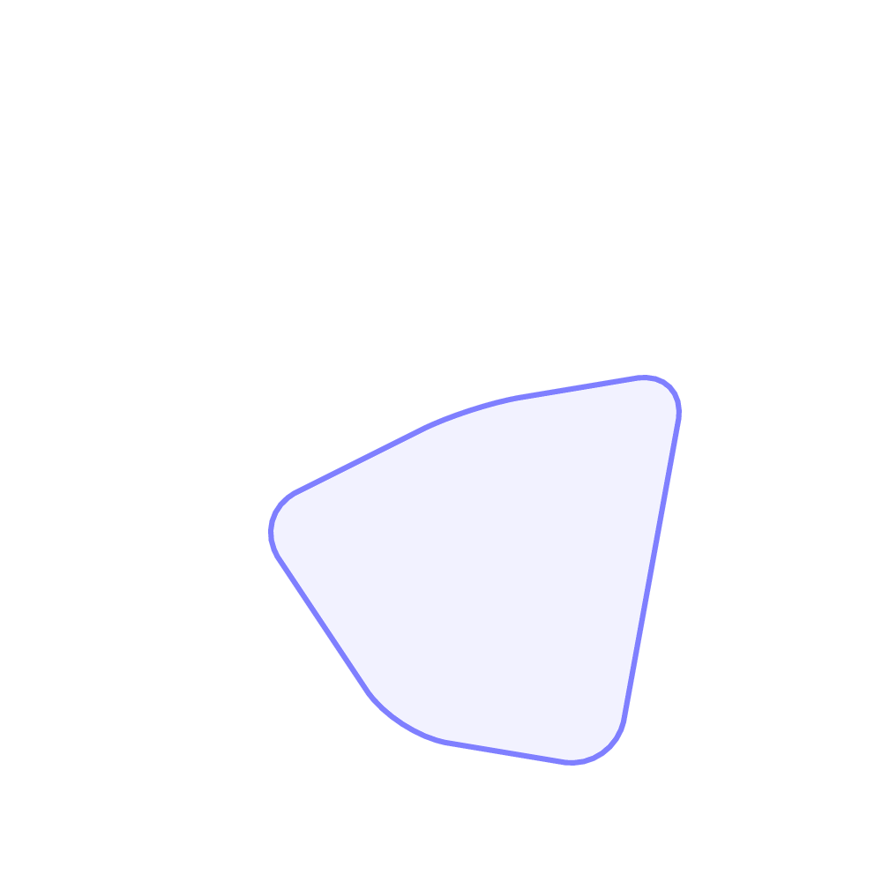

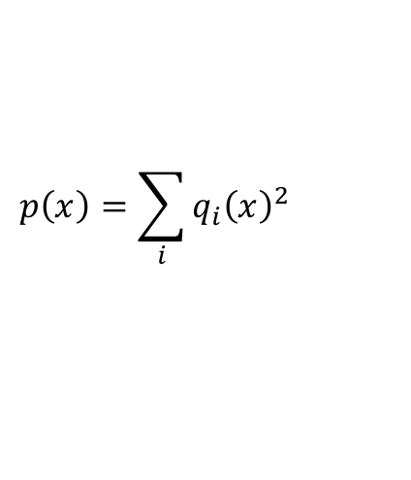

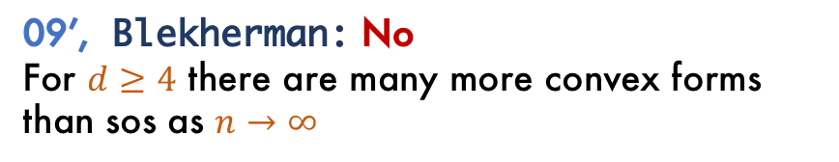
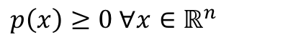
$p\left(x\right)≥0 ∀x∈ℝ^{n}$
07’, Parrilo: Convex SOS ?
?
09’, Blekherman: No
For $d≥4$ there are many more convex forms than sos as $n→∞$
Open problems:
No explicit examples are known!
Smallest $\left(n,2d\right)$ of such an example?
Minimal suspects:
$$\left(n,2d\right)=\left(4,4\right), (3,6)$$
$p$ conve𝒙
$$∇^{2}p(x)≽0$$
Today:
Convex quaternary quartic forms are sos.
$$p\left(x\right)=\sum_{i}{q_{i}{\left(x\right)}^{2}}$$
Notes:
The object of interest to us Is multivariate poly
When we study polynomials, a property that we are interested in is nonnegativity
I plotted for you here the set of all nonnegative polynomials in n d
Inside this set, we have two other sets of interest

Slide 5

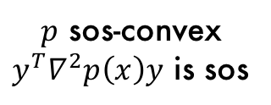
SOS-Convex Convex ✔
SOS-Convex SOS ✔
Computationally attractive!
Convex SOS-Convex ?
$p$ sos-convex
$y^{T}∇^{2}p\left(x\right)y$ is sos
[Helton, Nie]
[Ahmadi, Blekherman, Parrilo]
Notes:
This table seems to be the answer to all questions regarding classification of real forms

Slide 6

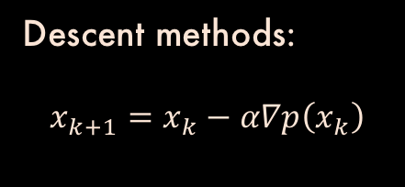
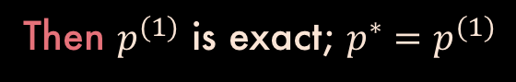
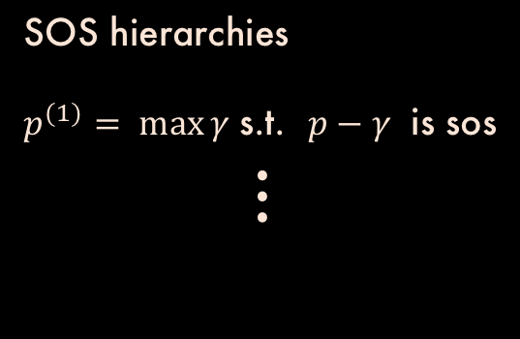
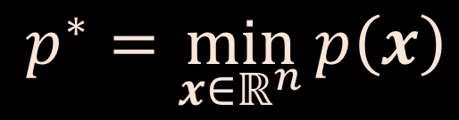
$$p^{∗}=\min_{x∈ℝ^{n}}{p\left(x\right)}$$
$p$ convex polynomial
always convex
Descent methods:
$$x_{k+1}=x_{k}−α∇p\left(x_{k}\right)$$
SOS hierarchies
$p^{(1)}= \max{γ}$s.t. $p−γ$ is sos
$$⋮$$
If we knew that $p−γ$ nonnegative $⇒p−γ$ sos
Then $p^{(1)}$ is exact; $p^{∗}=p^{(1)}$

Slide 7
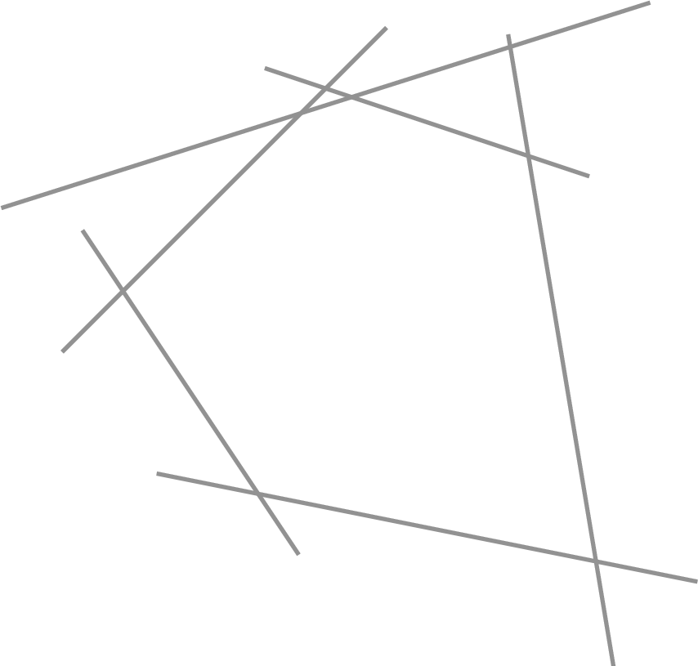

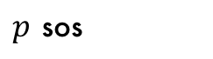
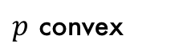
General outline of the proof
Theorem:
Convex quaternary quartic forms are sos.
$$p≥0$$
$p$ convex
$p$ sos

Slide 8
Dual of the cone of sos forms
Dual of the cone of convex forms

Slide 9
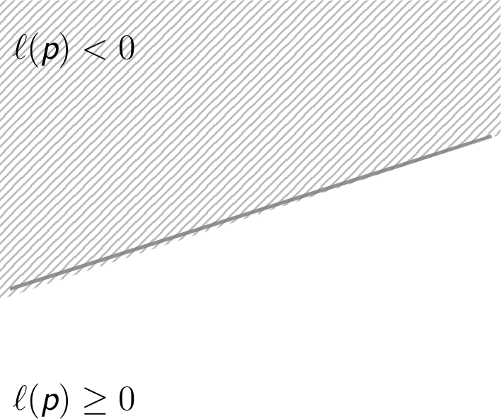
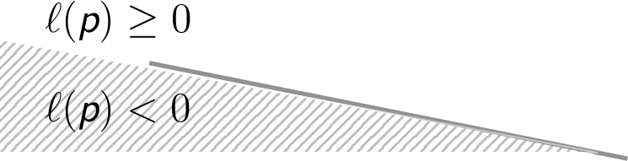
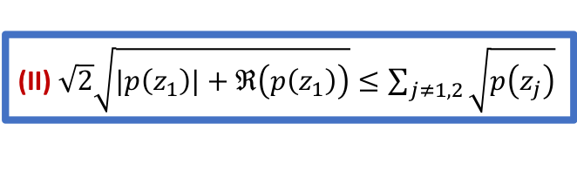
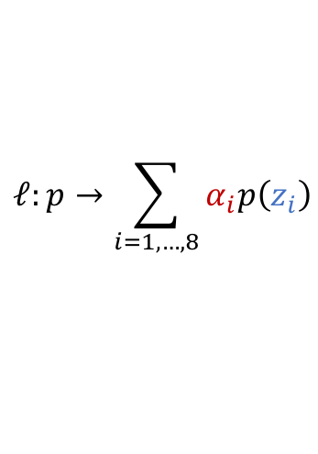
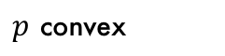
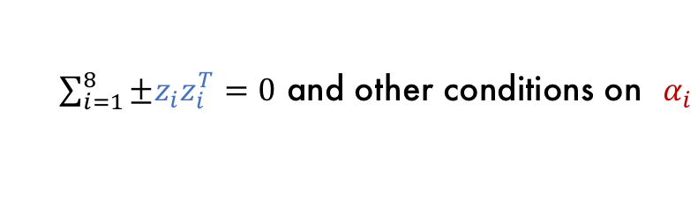

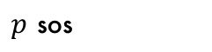
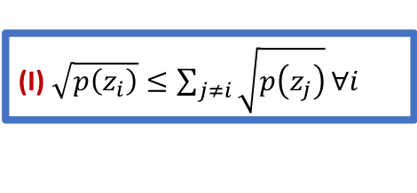

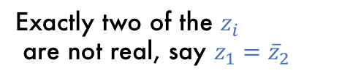
Dual of the sos cone $(n=4, 2d=4)$
$$ℓ:p→\sum_{i=1,…,8}{α_{i}p\left(z_{i}\right)}$$
[Blekherman, 2012]
$\sum_{i=1}^{8}{±z_{i}z_{i}^{T}}=0$ and other conditions on $α_{i}$
[Cayley-Bacharach]
$$p≥0$$
All $z_{i}^{ }$ are real
Exactly two of the $z_{i}^{ }$
are not real, say ${z_{1}={\overline{z}}_{2}}_{ }^{ }$
$p$ convex
$p$ sos
(I) $\sqrt{p\left(z_{i}\right)}≤\sum_{j≠i}{\sqrt{p\left(z_{j}\right)}}∀i$
(II) $\sqrt{2}\sqrt{|p\left(z_{1}\right)|+ℜ\left(p\left(z_{1}\right)\right)}≤\sum_{j≠1,2}{\sqrt{p\left(z_{j}\right)}}$
Takeaway: $p$ sos iff it satisfies (I) and (II)

Slide 10
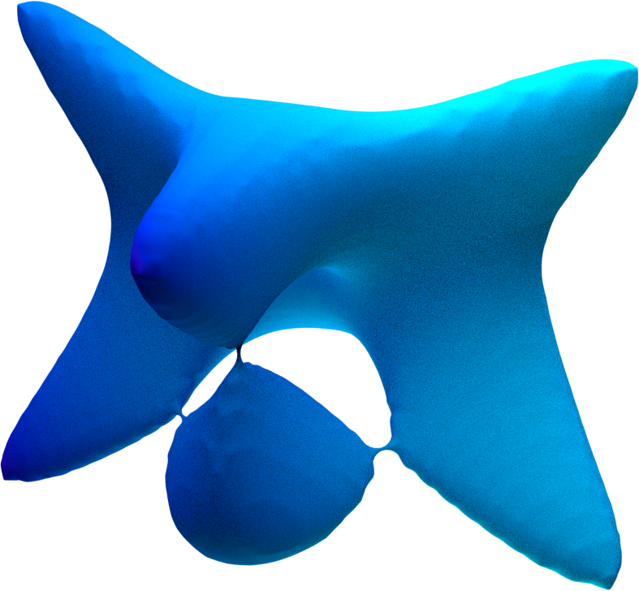
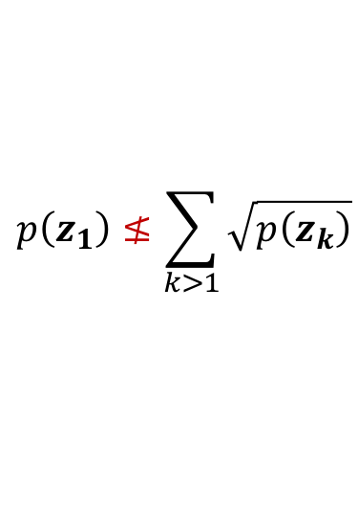
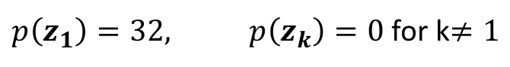
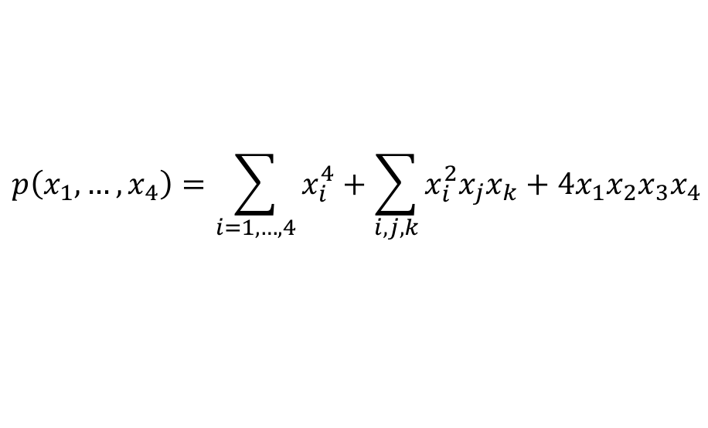
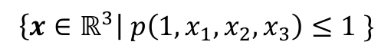

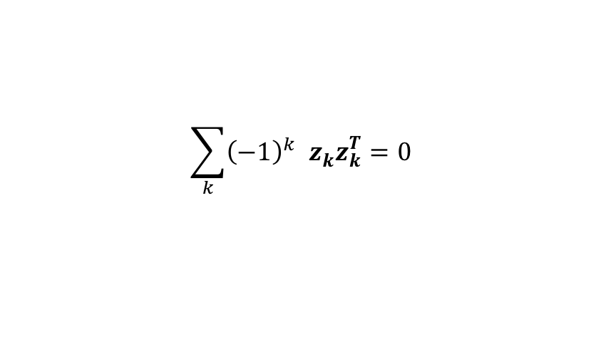
Example:
$$p\left(x_{1},…,x_{4}\right)=\sum_{i=1,…,4}{x_{i}^{4}}+\sum_{i,j,k}{x_{i}^{2}x_{j}x_{k}}+4x_{1}x_{2}x_{3}x_{4}$$
Not SOS
$$z_{1= }{\left(\begin{aligned}1 \\ 1 \\ 1 \\ 1\end{aligned}\right)}^{ },z_{2= }{\left(\begin{aligned}−1 \\ 1 \\ 1 \\ 1\end{aligned}\right)}^{ },…, z_{8}={\left(\begin{aligned}−1 \\ −1 \\ −1 \\ 1\end{aligned}\right)}^{ }$$
$$\sum_{k}{{\left(−1\right)}^{k} z_{k}^{ }z_{k}^{T}}=0$$
Cayley-Bacharach
$$\left\{x∈ℝ^{3}\right| p\left(1, x_{1},x_{2},x_{3}\right)≤1 \}$$
$p\left(z_{1}\right)=32, p\left(z_{k}\right)=0$ for k$≠1$
$$p\left(z_{1}\right)≰\sum_{k>1}{\sqrt{p\left(z_{k}\right)}}$$

Slide 11
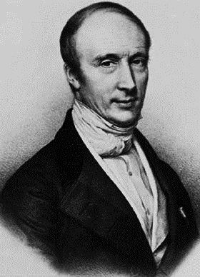
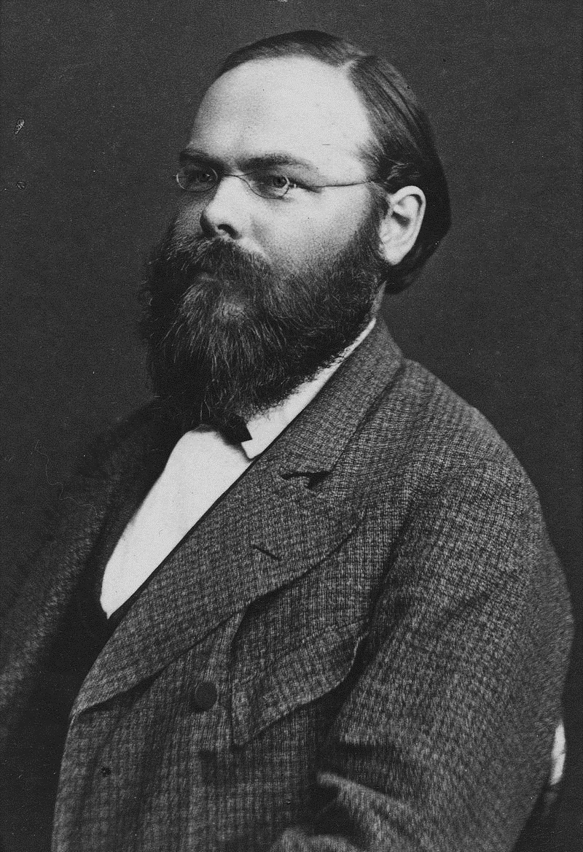
Dual of the cone of convex forms
Generalizations of Cauchy-Schwarz

Slide 12
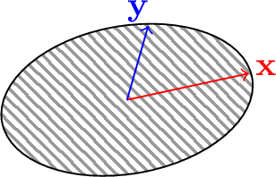
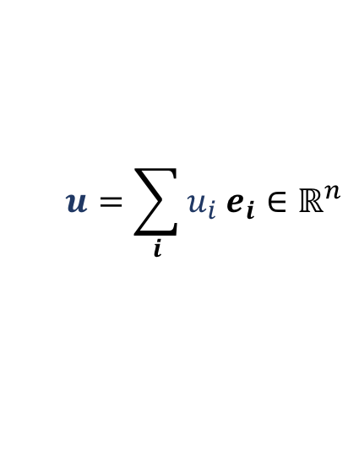
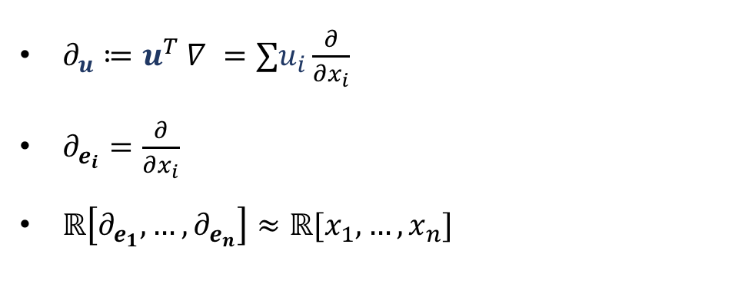
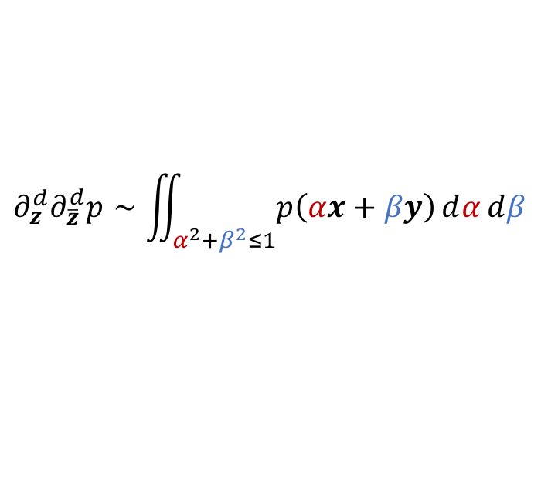
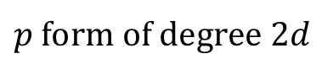
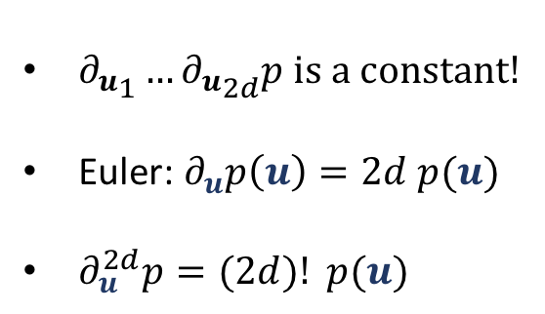
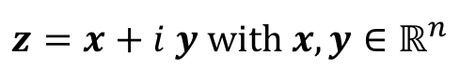
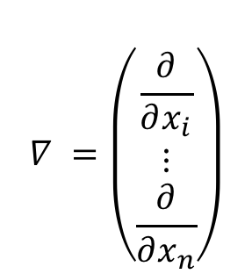
Background: Differential forms
$∂_{u}≔u^{T} ∇ =∑u_{i}\frac{∂}{∂x_{i}}$
$∂_{e_{i}}=\frac{∂}{∂x_{i}}$
$ℝ\left[∂_{e_{1}}, …,∂_{e_{n}}\right]≈ℝ[x_{1}, …, x_{n}]$
$$∇ =\left(\begin{matrix} \\ \begin{aligned}\frac{∂}{∂x_{i}} \\ ⋮ \\ \frac{∂}{∂x_{n}}\end{aligned}\end{matrix}\right)$$
$$u=\sum_{i}{u_{i} e_{i}}∈ℝ^{n}$$
${∂_{u}^{ }}_{1}…{∂_{u}^{ }}_{2d}p$ is a constant!
Euler: $∂_{u}p\left(u\right)=2d p(u)$
$∂_{u}^{2d}p=(2d)! p(u)$
$p$ form of degree $2d$
$$∂_{z}^{d}∂_{\overline{z}}^{d}p∼\iint_{α^{2}+β^{2}≤1}{p\left(αx+βy\right)ⅆαⅆβ}$$
$z=x+i y$ with $x,y∈ℝ^{n}$

Slide 13
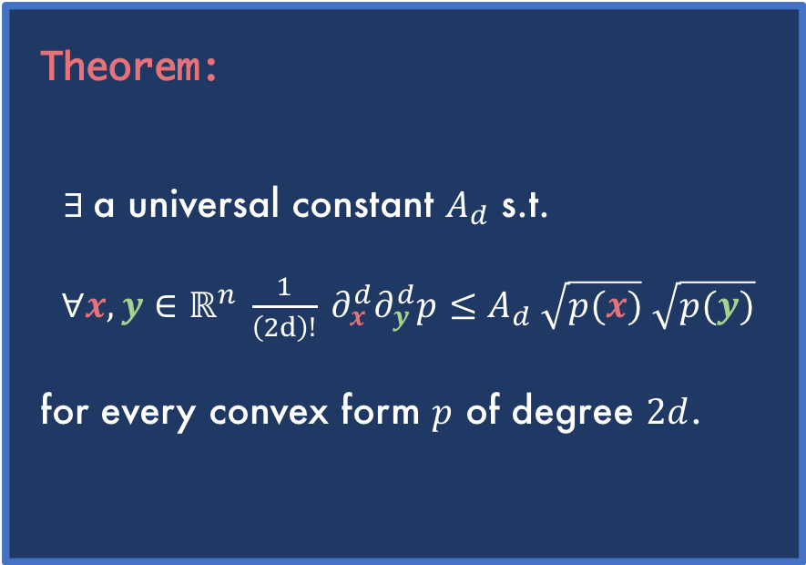


Generalized Cauchy-Schwarz Inequalities
Theorem:
$∃$a universal constant $A_{d}$ s.t.
$∀x,y∈ℝ^{n} \frac{1}{\left(2d\right)!} ∂_{x}^{d}∂_{y}^{d}p≤A_{d} \sqrt{p(x)} \sqrt{p(y)}$
for every convex form $p$ of degree $2d$.
Cauchy-Schwarz:
$$∀x,y∈ℝ^{n} x^{T}Qy≤\sqrt{x^{T}Qx} \sqrt{y^{T}Qy}$$
for every psd matrix $Q$.
$\frac{1}{2} ∂_{x}∂_{y}p≤\sqrt{p\left(x\right)} \sqrt{p\left(y\right)}$
for every convex quadratic form $p\left(x\right)=x^{T}Qx.$
$$q\left(α, β\right)=p\left(\frac{α}{p{\left(x\right)}^{\frac{1}{2d}}}x+\frac{β}{p{\left(y\right)}^{\frac{1}{2d}}}y\right)=c_{0}α^{2d}+c_{1}α^{2d−1}β+ …+c_{2d}β^{2d}$$

Slide 14












$p$ convex form of degree $2d,$ $x, y∈ℝ^{n}.$
Cauchy-Schwarz: $x^{T}y≤ \sqrt{x^{T}x} \sqrt{y^{T}y}$
$$\frac{1}{\left(2d\right)!} ∂_{x}^{d}∂_{y}^{d}p≤A \sqrt{p(x)} \sqrt{p(y)}$$
Enough to show: $x^{T}y≤\frac{x^{T}x{+y}^{T}y}{2}$
Why?
$$\frac{1}{\left(2d\right)!} ∂_{x}^{d}∂_{y}^{d}p≤A\frac{p\left(x\right)+p\left(y\right)}{2}$$
$x^{T}(λy)≤x^{T}x{+\left(λy\right)}^{T}(λy)$
$λ x^{T}y≤x^{T}x{+λ^{2}y}^{T}y$
take$λ=−\frac{x^{T}y}{2 y^{T}y}$
$$\frac{1}{\left(2d\right)!} ∂_{x}^{d}∂_{y}^{d}p≤\frac{A}{\left(2d\right)!} \frac{1}{2} \left(∂_{x}^{2d}p+∂_{y}^{2d}p\right)$$
$$0 ≤\left[A\frac{1}{2}\left(∂_{x}^{2d}+∂_{y}^{2d}\right)−∂_{x}^{d}∂_{y}^{d} \right] p$$
Linear Transformation: $x↦e_{1}, y↦e_{2}$
$$ℓ_{A}$$
$$ℓ_{A}(p)≔ \left[A\frac{1}{2}\left(∂_{e_{1}}^{2d}+∂_{e_{2}}^{2d}\right)−∂_{e_{1}}^{d}∂_{e_{2}}^{d} \right]p$$
min $A$
$ℓ_{A}\left(p\right)≥0 ∀p$ convex
Notes:
- Linearization
-Abstraction to du al

Slide 15











min $A$
$ℓ_{A}\left(p\right)≥0 ∀p$ quartic convex form in 2 vars
$$ℓ_{A}\left(p\right)≤0$$
$$ℓ_{A}\left(p\right)≥0$$
$$p\left(α,y\right)= {\left(α+β\right)}^{4}$$
$$c_{2}$$
$$p\left(α,β\right)= {\left(α−β\right)}^{4}$$
min $A$
Slice of the convex cone
$$c_{1}$$
$$c_{3}$$
$$p\left(α, β\right)=α^{4}+c_{1}α^{3}β+c_{2}α^{2}β^{2}+c_{3}αβ^{3}+β^{4}$$

Slide 16







$$\frac{1}{\left(2d\right)!} ∂_{x}^{d}∂_{y}^{d}p≤A_{d} \sqrt{p(x)} \sqrt{p(y)}$$
$$2d$$ | 2 | 4 | 6 | 8 | 10 | 12 | 14 | … | $$0 mod 4$$ | $$2 mod 4$$
$$A_{d}$$ | 1 | 1 | 1 | 1.01 | 1 | 1.06 | 1 | … | >1 | 1
?
(Conjecture)
Solving an SDP exactly:
Symmetries
KKT
Variable elimination
$$\frac{1}{70}ω^{\frac{1}{3}}+\frac{128}{15}ω^{\frac{1}{3}}+\frac{11}{35}≈1.011…$$
with $ω≔14336(1+i\frac{\sqrt{3}}{9})$
$$t^{3}−\frac{33}{35}t^{2}−\frac{17}{245}t+\frac{13}{42875}$$

Slide 17




Complex Cauchy-Schwarz
Catalan numbers describe the number of:
ways a polygon with $n+2$ sides can be cut into $n$ triangles.
ways to use n rectangles to tile a stair-step shape $(1, 2, …, n−1, n)$.
ways in which parentheses can be placed in a sequence of numbers to be multiplied, two at a time
planar binary trees with $n+1$ leaves
paths of length $2n$ through an $n$-by- $n$ grid that do not rise above the main diagonal
Real Cauchy-Schwarz: $\frac{1}{\left(2d\right)!} ∂_{x}^{d}∂_{y}^{d}p≤A_{d} \sqrt{p(x)} \sqrt{p(y)}$
Theorem:
$∀z∈ℂ^{n} \frac{1}{\left(2d\right)!}|p\left(z\right)| ≤B_{d}∂_{z}^{d}∂_{\overline{z}}^{d}p$
for every convex form $p$ of degree $2d$.
$B_{d}=\frac{\left({2\left(d−1\right) \atop d−1}\right)}{d}$ ($d^{th}$-Catalan number) = 1, 1, 2, 4 …
$$|p\left(z\right)|≤B_{d}^{′}\iint_{α^{2}+β^{2}≤1}{p\left(α ℜ(z)+βℑ(z) \right)ⅆαⅆβ}$$
Ingredients of the proof:
SDPs for intuition
Basic trigonometry

Slide 18


Proof of the complex Cauchy-Schwarz
Complex Cauchy-Schwarz: $B∂_{z}^{d}∂_{\overline{z}}^{d}p−\frac{1}{\left(2d\right)!}\left|p\left(z\right)\right|≥0$ ($B$ is the $d^{th}$-Catalan number).
Enough to show: $B∂_{z}^{d}∂_{\overline{z}}^{d}p−\frac{1}{\left(2d\right)!}ℜ(p\left(z\right))≥0$
Why? Linear Transformation: $z↦e^{iθ}z$
$$ℓ\left(p\right)=\sum_{i}{y_{i}^{T}∇^{2}p\left(x_{i}\right)y_{i}}$$
$$p: y^{T}∇^{2}p\left(x\right)y≥0 ∀x, y$$
Convex forms
Dual of convex forms

Slide 19



After some algebra, it all boils down to:
$$B−cos\left(2dθ\right)=\frac{4^{d}}{2d}\sum_{k=0,…,d−1}{{\cos^{2}\left(θ−\frac{π}{2d}k\right)\sin^{2d−2}\left(θ−\frac{π}{2d}k\right) }^{ }}∀θ∈ℝ$$
“The secret lives of polynomial identities”
Bruce Reznick

Slide 20








Putting everything together
Fix a convex quaternary quartic form $p$. Let’s show it is sos!
Let $z_{1},…, z_{8}∈ℝ^{4}$ such that:
$$z_{1}z_{1}^{T}=\sum_{i=2,…, 8}{±z_{i}z_{i}^{T}}$$
$$∂_{z_{1}}^{2}=\sum_{i=2,…, 8}{±∂_{z_{i}}^{2}}$$
$${∂_{z_{1}}^{2}}_{ }^{ }∂_{z_{1}}^{2}=\sum_{i,j=2,…, 8}{±}{∂_{z_{i}}^{2}}_{ }^{ }∂_{z_{j}}^{2}$$
$$\frac{1}{12}∂_{z_{1}}^{4}p=\frac{1}{12}\sum_{i=2,…, 8}{±∂_{z_{i}}^{2}}∂_{z_{j}}^{2}p$$
Generalized Cauchy-Schwarz:
$∀x,y∈ℝ^{4} \frac{1}{12} ∂_{x}^{2}∂_{y}^{2}p≤ \sqrt{p(x)p(y)}$
$$≤\sqrt{p\left(z_{i}\right)p\left(z_{j}\right)}$$
$$p\left(z_{1}\right)$$
We want to show (I): $\sqrt{p\left(z_{1}\right)}≤\sum_{i≥2}{\sqrt{p\left(z_{i}\right)}}$

Slide 21

What about convex ternary sextics? $$(n=3, 2d=6)$$

Slide 22



Ternary Sextics are very similar to Quaternary Quartics!
Good understanding of the dual of the sos cone
Type (I)
$∀x,y∈ℝ^{3} \frac{1}{6!} ∂_{x}^{3}∂_{y}^{3}p≤ \sqrt{p(x)} \sqrt{p(y)}$
✔
Type (II)
$∀z∈ℂ^{3} \frac{1}{6!} |p(z)|≤2∂_{z}^{3}∂_{\overline{z}}^{3}p$
✘
In which case, convex ternary sextics are also sos!
Conjecture: Type (II) might not be needed

Slide 23
Conclusion and open problems
Higher dimensions/number of variables?
Pattern in the optimal constants in the Generalized Cauchy-Schwarz?
Other applications of Generalized Cauchy-Schwarz?
Notes:
We lack both a good understanding of sos, and Cauchy schwarz constants are not 1

Slide 24

Thanks!
arxiv/1909.07546
Want to know more?
bachirelkhadir.com

Slide 25
Backup Slides
1

Slide 26



Slide 27




$$∂_{u}≔u^{T} ∇$$
$$=∑u_{i}\frac{∂}{∂x_{i}}$$
$$x^{T}Qy≤\sqrt{x^{T}Qx} \sqrt{y^{T}Qy}$$
$\frac{1}{\left(2d\right)!} ∂_{x}^{d}∂_{y}^{d}p≤\sqrt{p(x)} \sqrt{p(y)}$
$\frac{1}{2} ∂_{x}∂_{y}p≤\sqrt{p(x)} \sqrt{p(y)}$

Slide 28









Putting everything together
Fix a convex quaternary quartic form $p$.
Let $z_{1},…, z_{8}∈ℝ^{4}$ such that:
$$z_{1}z_{1}^{T}=\sum_{i=2,…, 8}{±z_{i}z_{i}^{T}}$$
$z_{1}z_{1}^{T}⊗z_{1}z_{1}^{T}=\sum_{i=2,…, 8}{±z_{i}z_{i}^{T}}$ $⊗z_{j}z_{j}^{T}$
Generalized Cauchy-Schwarz:
$∀x,y∈ℝ^{4} \frac{1}{12} ∂_{x}^{d}∂_{y}^{d}p≤ \sqrt{p(x)p(y)}$
$$\frac{1}{12}∂_{z_{1}}^{4}p=\frac{1}{12}\sum_{i=2,…, 8}{±∂_{z_{i}}^{2}}∂_{z_{j}}^{2}p$$
$$∂_{z_{1}}^{4}=\sum_{i=2,…, 8}{±∂_{z_{i}}^{2}}∂_{z_{j}}^{2}$$
$$≤\sqrt{p\left(z_{i}\right)p\left(z_{j}\right)}$$
$$p\left(z_{1}\right)$$
We want to show (I):
$$\sqrt{p\left(z_{1}\right)}≤\sum_{i≥2}{\sqrt{p\left(z_{i}\right)}}$$
Notes:
Pass to te sors

Slide 29


$$V=\left\{{\left(\begin{aligned}1 \\ 1 \\ 1 \\ 1\end{aligned}\right)}^{ },{\left(\begin{aligned}−1 \\ −1 \\ 1 \\ 1\end{aligned}\right)}^{ },{\left(\begin{aligned}1 \\ −1 \\ −1 \\ 1\end{aligned}\right)}^{ },{\left(\begin{aligned}−1 \\ 1 \\ −1 \\ 1\end{aligned}\right)}^{ },{\left(\begin{aligned}−1 \\ 1 \\ 1 \\ 1\end{aligned}\right)}^{ },{\left(\begin{aligned}1 \\ −1 \\ 1 \\ 1\end{aligned}\right)}^{ },{\left(\begin{aligned}1 \\ 1 \\ −1 \\ 1\end{aligned}\right)}^{ },{\left(\begin{aligned}−1 \\ −1 \\ −1 \\ 1\end{aligned}\right)}^{ }\right\}$$
$${\left(\begin{aligned}1 \\ 1 \\ 1 \\ 1\end{aligned}\right)}^{2}+{\left(\begin{aligned}−1 \\ −1 \\ 1 \\ 1\end{aligned}\right)}^{2}+{\left(\begin{aligned}1 \\ −1 \\ −1 \\ 1\end{aligned}\right)}^{2}+{\left(\begin{aligned}−1 \\ 1 \\ −1 \\ 1\end{aligned}\right)}^{2}−{\left(\begin{aligned}−1 \\ 1 \\ 1 \\ 1\end{aligned}\right)}^{2}−{\left(\begin{aligned}1 \\ −1 \\ 1 \\ 1\end{aligned}\right)}^{2}−{\left(\begin{aligned}1 \\ 1 \\ −1 \\ 1\end{aligned}\right)}^{2}−{\left(\begin{aligned}−1 \\ −1 \\ −1 \\ 1\end{aligned}\right)}^{2}=0$$

Slide 30

Restatement of Thm:
$∃$universal constant $A_{d}$ s.t.
$$\frac{{d!}^{2}}{\left(2d\right)!}c_{d} ≤A_{d}$$
for every bivariate conve𝒙 form $q$ of degree $2d$ with $q(1,0) = q(0, 1) = 1$.

Slide 31











Max $A$
$ℓ_{A}\left(p\right)≥0 ∀p∈C_{2,2d}$
$$ℓ_{A}\left(p\right)≤0$$
max $A$
$$ℓ_{A}\left(p\right)≥0$$
$$p\left(α,β\right)= {\left(α+β\right)}^{4}$$
$$c_{2}$$
$$p\left(α,y\right)= {\left(α+β\right)}^{4}$$
$$c_{1}$$
Slice Convex forms
$$c_{3}$$
$$q\left(α, β\right)=α^{4}+c_{1}α^{3}β+c_{2}α^{2}β^{2}+c_{3}αβ^{3}+β^{4}$$

Slide 32

$$\frac{1}{\left(2d\right)!} ∂_{e_{1}}^{d}∂_{e_{2}}^{d}q≤A_{d} \sqrt{q(e_{1})} \sqrt{q(e_{2})}$$

Slide 33








Proof of the complex Cauchy-Schwarz (1/2)
$$p: y^{T}∇^{2}p\left(x\right)y≥0 ∀x, y$$
Complex Cauchy-Schwarz: $B∂_{z}^{d}∂_{\overline{z}}^{d}p−\frac{1}{\left(2d\right)!}|p(z)|≥0$
($B$ is the $d^{th}$-Catalan number).
Enough to show: $B∂_{z}^{d}∂_{\overline{z}}^{d}p−\frac{1}{\left(2d\right)!}ℜ(p\left(z\right))≥0$
Convex forms
$$ℓ_{B}(p)$$
$$ℓ_{B}:=B∂_{z}^{d}∂_{\overline{z}}^{d}−ℜ\left(∂_{z}^{2d}\right)$$
$$ℓ\left(p\right)=\sum_{i}{y_{i}^{T}∇^{2}p\left(x_{i}\right)y_{i}}$$
$$ℓ=\sum_{i}{∂_{x_{i}}^{2}}∂_{y_{i}}^{2d−2}$$
Why? Linear Transformation: $z↦e^{iθ}z$
Enough to show for $z=e_{1}+i e_{2}$
Why? $z=x+i y, x↦e_{1}, y↦e_{2}$
$$ℓ_{B}=B{\left|∂_{e_{1}}^{ }+i∂_{e_{2}}^{ }\right|}^{2d}−ℜ\left({\left(∂e_{1}+i∂e_{2}\right)}^{2d}\right)$$
$$ℓ_{B}≈B{\left|x+iy\right|}^{2d}−ℜ\left({\left(x+iy\right)}^{2d}\right)$$
$$ℝ\left[∂_{e_{1}}, ∂_{e_{2}}\right]≈ℝ[x, y]$$
Dual of convex forms

Slide 34





Proof of the complex Cauchy-Schwarz (2/2)
$$p: y^{T}∇^{2}p\left(x\right)y≥0 ∀x, y$$
Complex Cauchy-Schwarz:
$$B∂_{z}^{d}∂_{\overline{z}}^{d}p−\frac{1}{\left(2d\right)!}|p(z)|≥0$$
Can we write
$$ℓ_{B}=B{|x^{ }+iy^{ }|}^{2d}−ℜ\left({\left(x+iy\right)}^{2d}\right)$$
as
$$\sum_{k}{{\left(−a_{k}x+b_{k}y\right)}^{2}{\left(c_{k}x+d_{k}y\right)}^{2d−2}}$$
?
Convex forms
$$ℓ\left(p\right)=\sum_{i}{y_{i}^{T}∇^{2}p\left(x_{i}\right)y_{i}}$$
$$ℓ=\sum_{i}{∂_{x_{i}}^{2}}∂_{y_{i}}^{2d−2}$$
$$x=r\cos{θ}, y=r\sin{θ}$$
$$B{|x+iy^{ }|}^{2d}−ℜ\left({\left(x+iy\right)}^{2d}\right)=r^{2d}(B−cos\left(2dθ\right))$$
$$B−cos\left(2dθ\right)=\frac{4^{d}}{2d}\sum_{k=0,…,d−1}{{\cos^{2}\left(θ−\frac{π}{2d}k\right)\sin^{2d−2}\left(θ−\frac{π}{2d}k\right) }^{ }}$$
Dual of convex forms

Slide 35



$$p≥0$$
$p$ convex
$p$ sos
Notes:
The object of interest to us Is multivariate poly
When we study polynomials, a property that we are interested in is nonnegativity
I plotted for you here the set of all nonnegative polynomials in n d
Inside this set, we have two other sets of interest

